Slide 1
Kubernetes
Kubernetes
Kubernetes
Kubernetes

Slide 2
Agenda
Pain Areas of Docker running in Standalone
Motivation
What is Kubernetes?
Kubernetes Architecture
Objects

Slide 3
Pain Areas of Docker running in Standalone
Scaling Application instances.
Mounting storage systems.
Application health checking.
Replicating application instances.
Horizontal auto-scaling.
Naming and discovery.
Load balancing.
Rolling updates.
Resource monitoring.
Identity and authorization.

Slide 4
Motivation
Workloads have shifted from using VMs to containers
Better resource utilization
Faster deployment
Simplifies config and portability
More than just scheduling
Load balancing
Replication for services
Application health checking
Ease of use for
Scaling
Rolling updates

Slide 5
What is Kubernetes
Greek for “pilot” or “helmsman of a ship” aka k8s
The open source cluster manager from Google
Written in Go
Manage Containers, not Machines
Current state → desired state

Slide 6
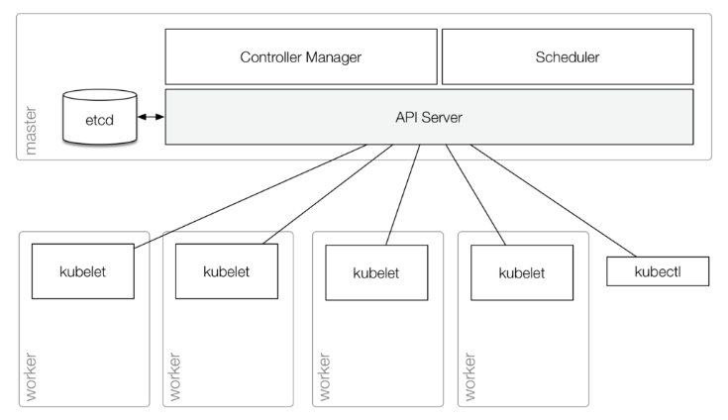
Kuberetes Arch

Slide 7
Architecture
Master node
Typically consists of:
● kube-apiserver : Front end to the control plane, Exposes REST API, Consumes JSON,YAML (manifest files)
● kube-scheduler : Watches apiserver for new pod,Assigns work to node
i. Affinity/anti-affinity
ii. Contraints
iii. Resources.
● kube-controller-manager : Watches for changes ,helps maintain desired count.
● etcd : distributed ,watchable,consistent database, stores key-value pair ,Nosql database,Open source by COREOS

Slide 8
Architecture
Worker node
Typically consists of:
● kubelet : agent, manages pods, containers, images and volumes
● kube-proxy : watches apiserver
● Container engine : Does container Managment

Slide 9
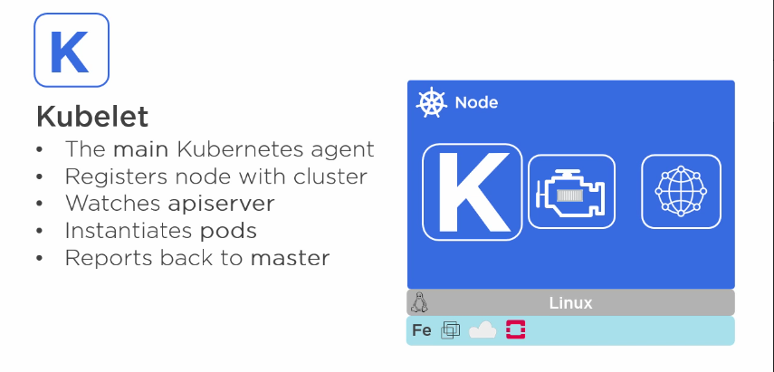

Slide 10
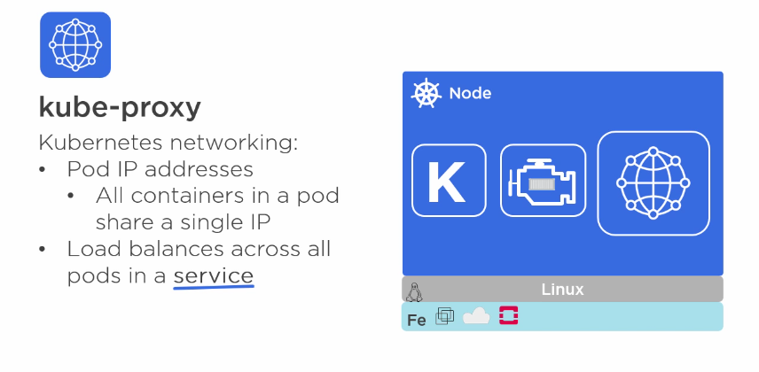

Slide 11
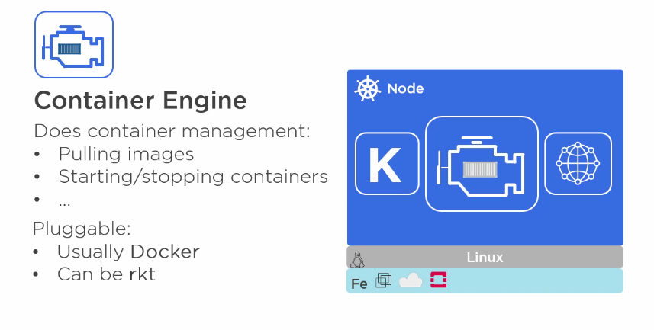

Slide 12
Overview
Specification file (json/yaml)
Master
API
API Server
kubelet
CLI
kubelet
UI

Slide 13
Sample specification
apiVersion: v1
kind: object_kind
metadata:
name: name_of_Object
labels:
key: value
spec:
containers:
- name: name_of_Container
image: name_of_Image
ports:
- containerPort: container_Port

Slide 14
Objects
Pods
Deployment
Service
Labels & Selector
Namespaces

Slide 15
Pods
Pod is a group of containers that are deployed together on the same host.
Pods are always co-located and co-scheduled, and run in a shared context.
One or more containers
share IP and localhost
share same volume
Every pod gets an unique IP
Deploy single containers, you can generally replace the word "pod" with "container“.

Slide 16
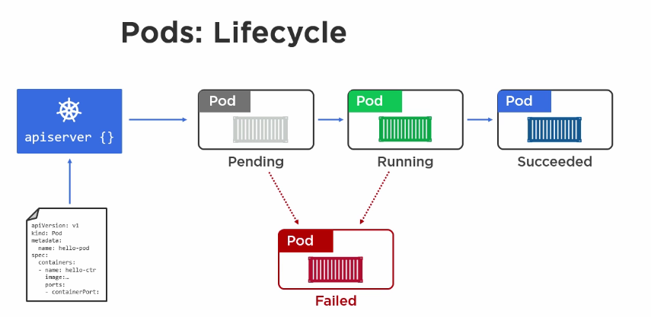

Slide 17
Deployment
Consists of
Pod template
Count
Label Selector
Kube will try to keep $count copies of pods matching the label selector running.
Rollback to an earlier Deployment revision if the current Deployment isn’t stable.
Pause and resume a Deployment

Slide 18
Labels & Selector
Key-value pairs that are attached to objects
With label selector, the client/user can identify a set of objects.
The label selector is the core grouping primitive in Kubernetes.
Can be attached to objects at creation time and can be added and modified at any time.

Slide 19
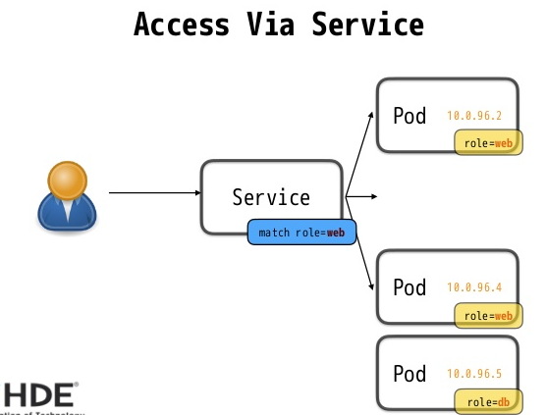
Service
A set of running pods accessible by virtual IP
Internal Load balancer

Slide 20
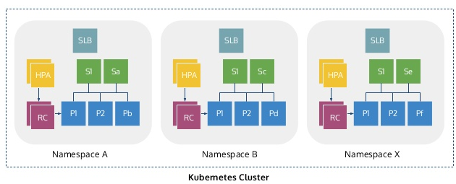
Namespaces
Mechanism to partition cluster into logically named group
Can be used in environments with many users spread across multiple teams, or projects
Provides scope for –
named resources (to avoid naming collisions)
authority to trusted users

Slide 21
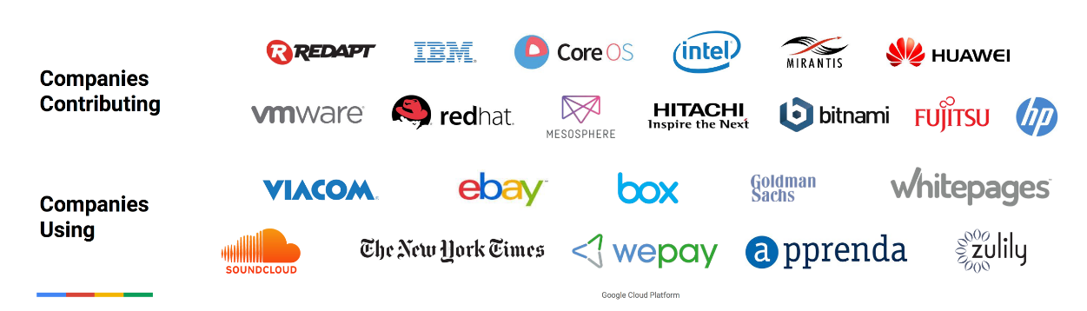
Companies using/contributing K8s

Slide 22
Bibliography, Important Links
http://kubernetes.io/docs/
http://kubernetes.io/docs/user-guide/docker-cli-to-kubectl/
Online learning course : https://www.udacity.com/course/scalable-microservices-with-kubernetes ud615

